Slide 1


STRATEGIC PLAN: INNOVATION LAB
Your logo here!!
PERIOD: 2024 / 2026

Slide 2




Slide 3
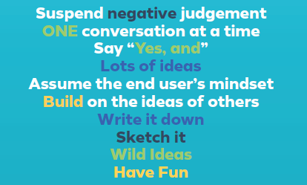


Slide 4

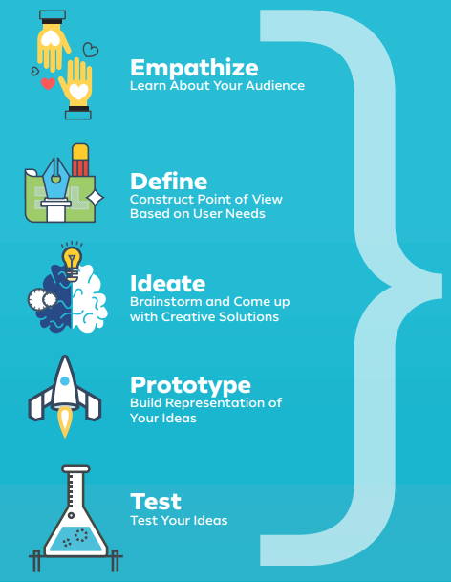
DESIGN THINKING

Slide 5
Leadership & Succession
Is leadership identified? (Empathy)
Is there a clear responsible party or overlap?
Is there a transition plan?
(Define)
Is there a pipeline of volunteers or a successor ready to take the helm?
Is there a talent shortage?
(Define)
Is this an area where it is difficult to find volunteers? Why? What will increase the appeal of this opportunity?
Resilience
Is it sustainable? (Empathy)
Does the level of effort support the outcomes we are receiving?
Is it at risk? (Define)
Are there programs that have business continuity contingencies? Can we overcome these?
Is it inclusive? (Empathy)
Do all members of the chapter have access to member benefits at all times?
Innovation
Is it feasible? (Define)
Does the technology exist to accomplish this at a reasonable cost or in an acceptable amount of time?
Is it Desirable? (Empathy)
Does anyone want or need this?
Is it viable? (Ideation)
Does it have a reasonable chance of succeeding

Slide 6
CHAPTER OPERATIONS
INNOVATION | RESILIENCE | SUCCESSION AND LEADERSHIP
Notes:
Empathy:
Design:
Ideate:
Prototype:
Test:

Slide 7

How might we optimize Chapter Operations ?
Breakout Room Activity
No. | Define Challenge/ Opportunity | Ideate Solutions
1. | Innovation
2. | Resilience
3. | Succession & Leadership
Notes:
Empathy:
Define:
Ideate:
Prototype:
Test:

Slide 8
Chapter operations
Group Activity
NO. | OBJECTIVE | INITIATIVE | PRIORITY (High/Mod./Low) | CHAMPION (Prototype/Test) | 2024 | 2025 | 2026
1
2
3

Slide 9
MEMBERSHIP
INNOVATION | RESILIENCE | SUCCESSION AND LEADERSHIP
Notes:
Empathy:
Design:
Ideate:
Prototype:
Test:

Slide 10
How might we best serve our membership?
Breakout Room Activity
No. | Define Challenge/ Opportunity | Ideate Solutions
1. | Innovation
2. | Resilience
3. | Succession & Leadership
Notes:
Empathy:
Define:
Ideate:
Prototype:
Test:

Slide 11
membership
Group Activity
NO. | OBJECTIVE | INITIATIVE | PRIORITY (High/Mod./Low) | CHAMPION (Prototype/Test) | 2024 | 2025 | 2026
1 | Innovation
2 | Resilience
3 | Succession & Leadership

Slide 12
ADVOCACY & OUTREACH
INNOVATION | RESILIENCE | SUCCESSION AND LEADERSHIP
Notes:
Empathy:
Design:
Ideate:
Prototype:
Test:

Slide 13
How might we advocate for the profession?
Breakout Room Activity
No. | Define Challenge/ Opportunity | Ideate Solutions
1. | Innovation
2. | Resilience
3. | Succession & Leadership
Notes:
Empathy:
Define:
Ideate:
Prototype:
Test:

Slide 14
advocacy
Group Activity
NO. | OBJECTIVE | INITIATIVE | PRIORITY (High/Mod./Low) | CHAMPION (Prototype/Test) | 2024 | 2025 | 2026
1 | Innovation
2 | Resilience
3 | Succession & Leadership

Slide 15
PROFESSIONAL DEVELOPMENT
INNOVATION | RESILIENCE | SUCCESSION AND LEADERSHIP
Notes:
Empathy:
Design:
Ideate:
Prototype:
Test:

Slide 16
How might we develop competent professionals?
Breakout Room Activity
No. | Define Challenge/ Opportunity | Ideate Solutions
1. | Innovation
2. | Resilience
3. | Succession & Leadership
Notes:
Empathy:
Define:
Ideate:
Prototype:
Test:

Slide 17
Professional development
Group Activity
NO. | OBJECTIVE | INITIATIVE | PRIORITY (High/Mod./Low) | CHAMPION (Prototype/Test) | 2024 | 2025 | 2026
1 | Innovation
2 | Resilience
3 | Succession & Leadership

